Slide 1

Team UncertainSea
Met Office Hackathon: Coastal & Marine Challenge
17th March 2021

Slide 2
Overview

Slide 3
UncertainSea Project summary
N.B. Only median ESLs used - 2.5th and 97.5th percentiles of ESLs not used in tandem with projections as UKCP18 Marine Report acknowledges it’s non-trivial to combine the uncertainty of skew surge stats with future climate projections.
[It’s not clear these are independent and also not clear how the 90% confidence interval in UKCP18 should interact with the 95% confidence interval in ESLs. If they are independent, should be able to simply add uncertainties squared at least…]
Input
Source: Met Office (non-public dataset?)
Present Day ESLs: e.g. TheMumbles_present_ea_sea_levels.pkl
Future ESLs: e.g. TheMumbles_future_ea_plus_ukcp18_sea_levels.pkl
Python pickle file of median localised SW Wales Environment Agency Extreme Sea Level return periods with UKCP18 projected sea level rise included
Processing
get_sealevels.py: Extreme sea levels + confidence bounds extracted for different return periods for a defined location, plus same data for RCPs (2.6, 4.5 or 8.5) and time (2025, 2055, 2100).
Processing
e.g. l50_2025_85.shp [Percentile_ReturnPeriod_ Year_RCP.shp; where percentile l = lower = 5th, m = medium = 50th, u = upper = 95th]
Still water levels from step [2] used to create the polygons for each ESL percentile for a given RCP projection at each time horizon
Output
Assembled in Blender:
Shapefiles from step [3] (using Safe Software’s FME)
5m DTM from Ordnance Survey (non-public dataset) [looked into higher resolution LiDAR but was found to be patchy]
Transferred to Unity (a ‘game engine’) for final product

Slide 4
Further considerations / feedback from panel
Potential applications
Could use at COP e.g. VR headsets
Appealing to younger audiences especially parallels to gaming
Additional dynamics e.g.
Animation to ‘fill up’ from current to future still water level, instead of static polygons
Or could show a gradient oppose to just upper, mid, and lower layers
Additional risk factors
Fluvial (and pluvial?) flooding, especially around estuaries
Coastal erosion
Change in population / exposure
Change in flood defences
Comparing to natural variability

Slide 5
Further details
Other data sources considered
Raw UKCP18 data (via CEDA database): seaLevelAnom_marine-sim_rcp26_ann_2007-2100.nc
Sea level anomalies for UK coastline – only rise in tides, no storm component
Processed UKCP18 data: Newport_future_ukcp18_sea_level_anoms.pkl?
Present risk of coastal flooding
Future risk of coastal flooding
N.B. Future UK storm surge doesn’t show clear trend from future climate change – signal dominated by natural variability (hence using EA’s ESL stats in this project)
Extreme Sea Levels at defined return periods
5th, 50th, 95th percentiles → uncertainty from downscaling, ice melt
2.5th 50th, 97.5th percentiles → uncertainty in skew surge joint probability statistics
Risk projected to future climate RCP 2.6, RCP 4.5, RCP 8.5

Slide 6
Final Slide

Slide 7





Team UncertainSea
Inputs
Present Day Extreme Sea Levels
UKCP18 sea level projections
Goal
Visualise uncertainties in future Extreme Sea Level for stakeholders, highlighting coastal flood risk is not binary.
Projected future still water return level dataset used to visualise coastal flood risk
Uncertainty in ESL using the 95% confidence interval in skew surge joint probability statistics
Uncertainty from climate projections downscaling and ice melt considered using the 90% confidence interval in the RCP 2.6, 4.5 and 8.5 mean sea level projections
Time horizons: Shoreline management plan epoch end dates (2025, 2055, 2100)
Case Study location: Swansea
Notes:
Goal
Interactive way of showing uncertainty in future coastal flood risk
Input data
Types of uncertainty
Why Swansea?
NRW
Growth area
Strategically significant
UK wide
Context
Purpose → making uncertainty in future flood risk clearer to stakeholders
Legacy: The UncertainSea Virtual Tool
Height exaggeration x2
Blue 5th → green 50th → red 95th
Next steps: More layers, include ESL confidence intervals
Town halls
Stakeholder engagements
Conferences
Why we chose extreme sea levels?
Policy perspective → planning e.g. 1-in-200year
Context for decision making
Highlight Kevin Horsburgh 95th percentile event
Time horizons: Local government planning epoch end date (2025, 2055, 2100)
Case Study location: Swansea

Slide 8
Workings / more details

Slide 9

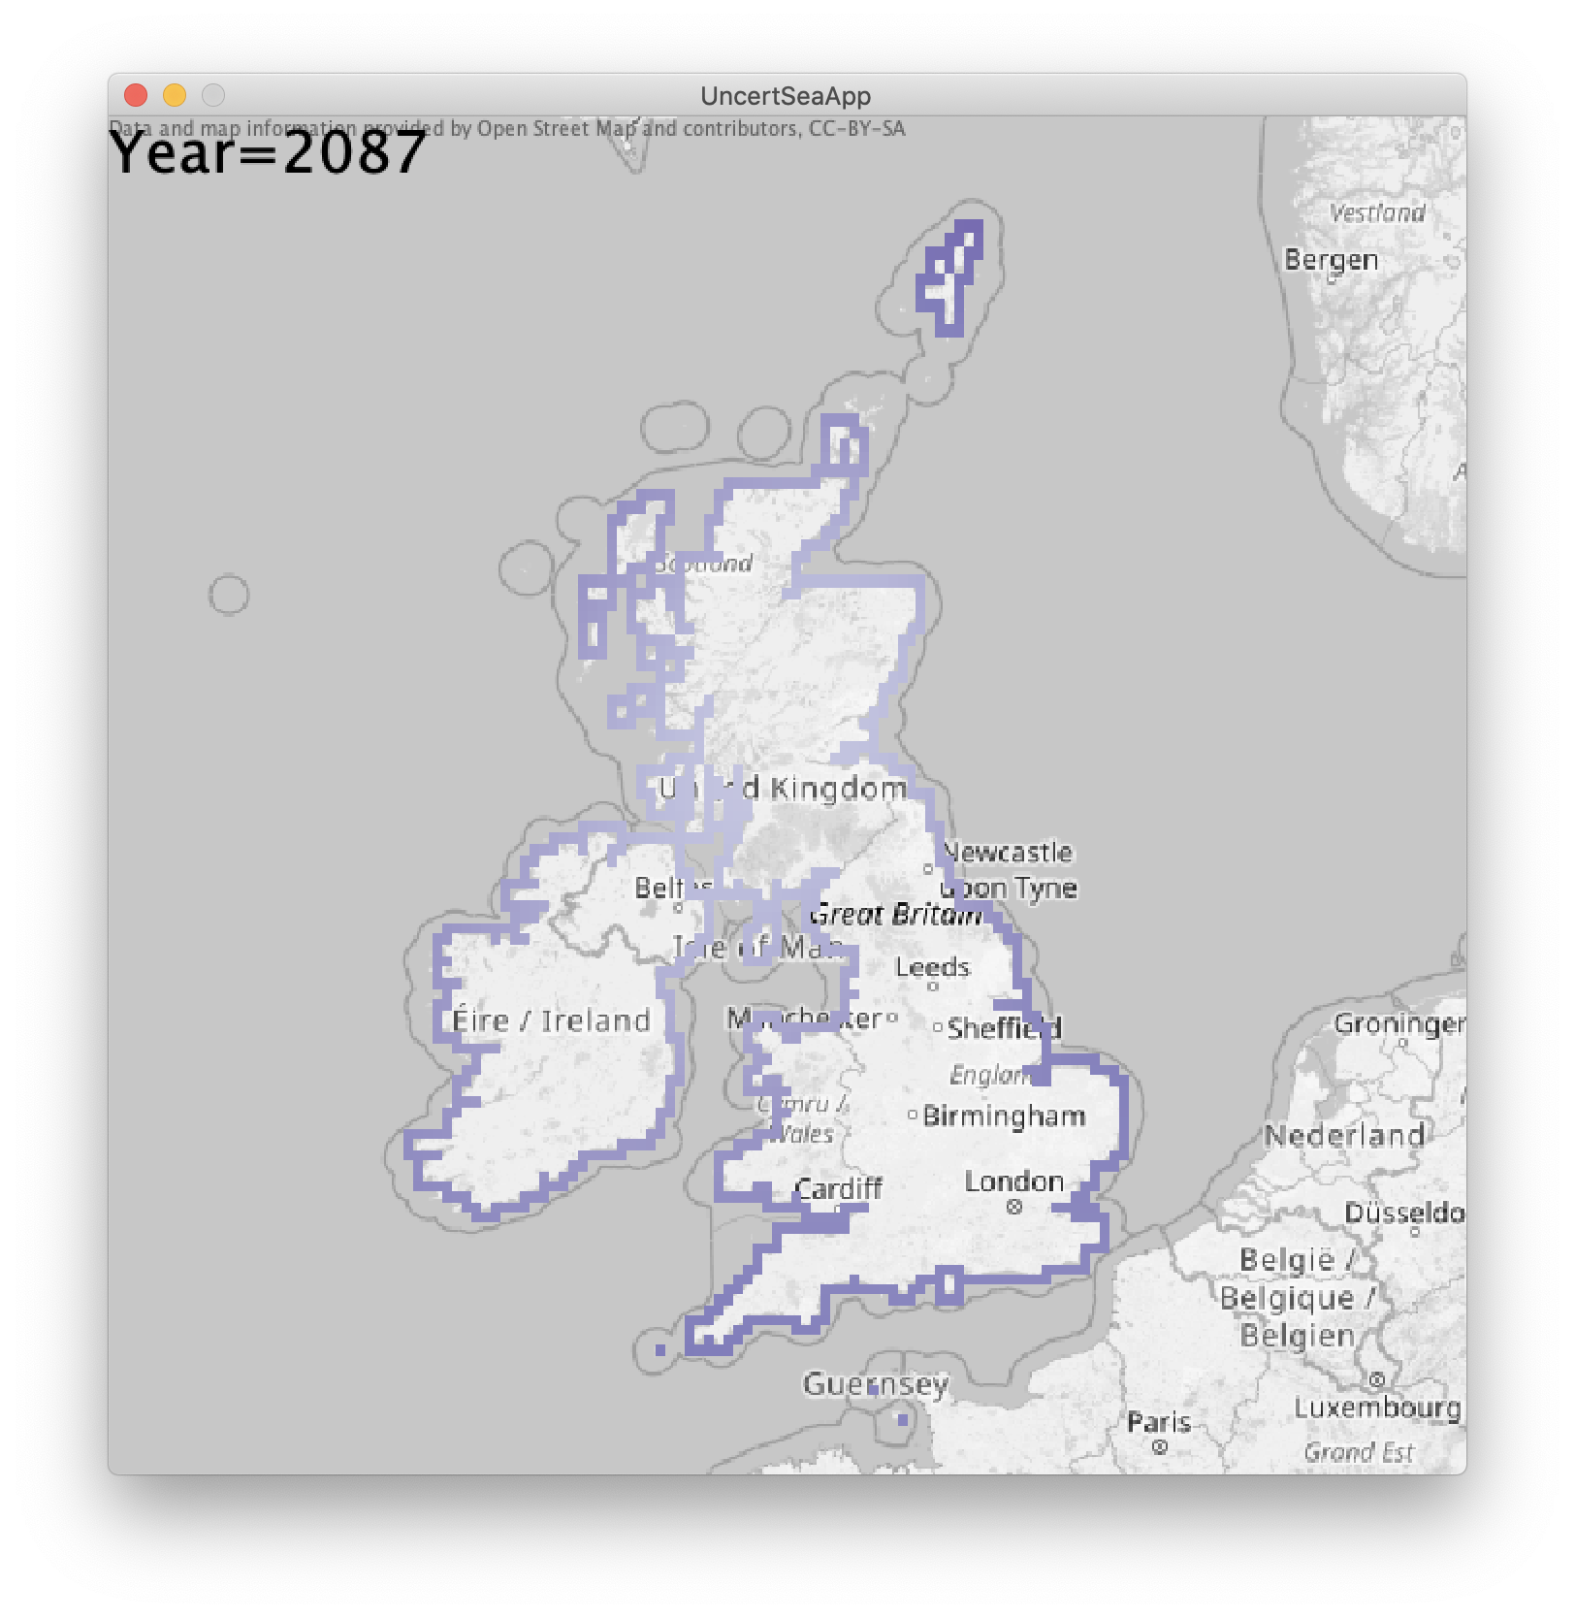
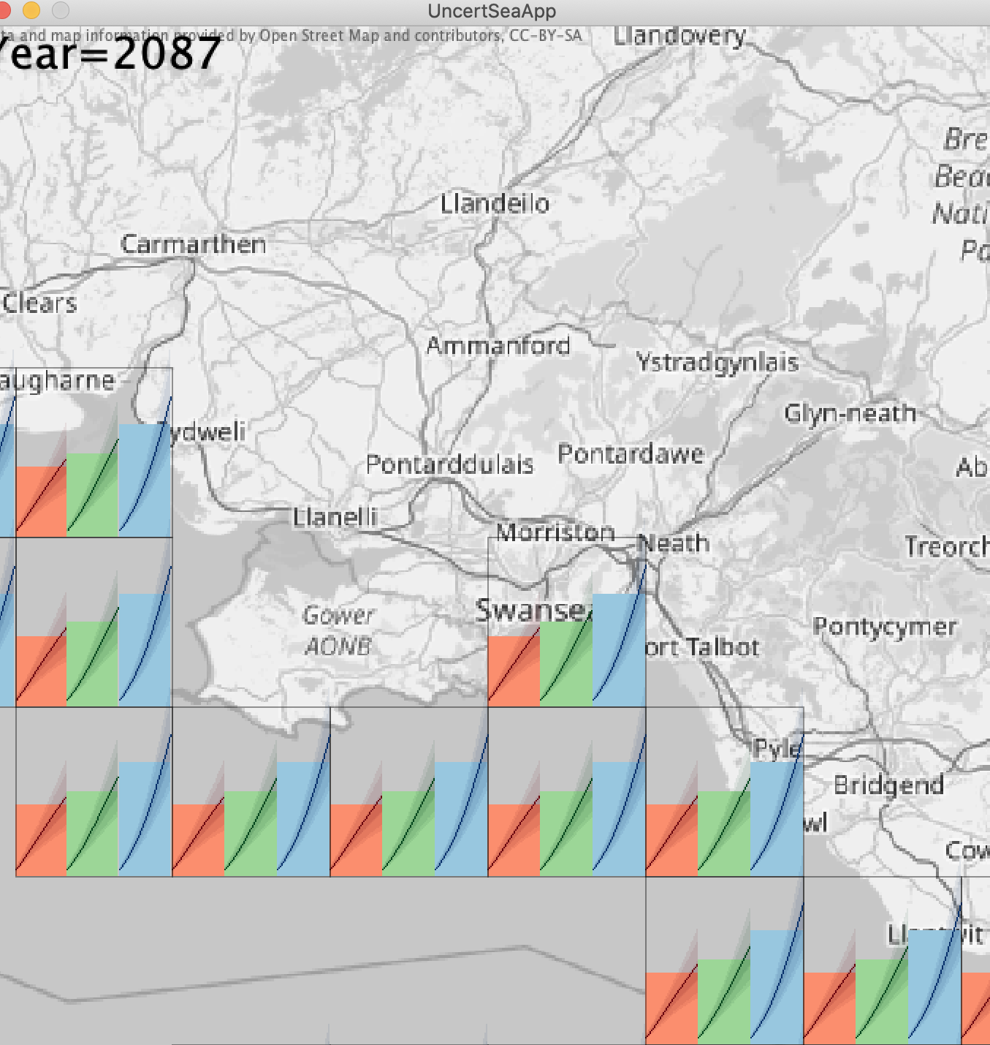
Team UncertainSea
Inputs
Present Day Extreme Sea Levels
UKCP18 sea level projections
Goal
Visualise uncertainties in future Extreme Sea Level for stakeholders, highlighting coastal flood risk is not binary.
Uncertainty from skew surge joint probability statistics
Uncertainty from climate projections downscaling, ice melt
Outputs
Uncertainties in UK-wide mean sea level rise
Town halls
Stakeholder engagements
Conferences
Future Coastal Flood Risk
The UncertainSea Virtual Tool
Live demo…
Notes:
Why we chose extreme sea levels?
Policy perspective → planning e.g. 1-in-200year
Context for decision making
Highlight Kevin Horsburgh 95th percentile event
Time horizons: Local government planning epoch end date (2025, 2055, 2100)
Case Study location: Swansea

Slide 10
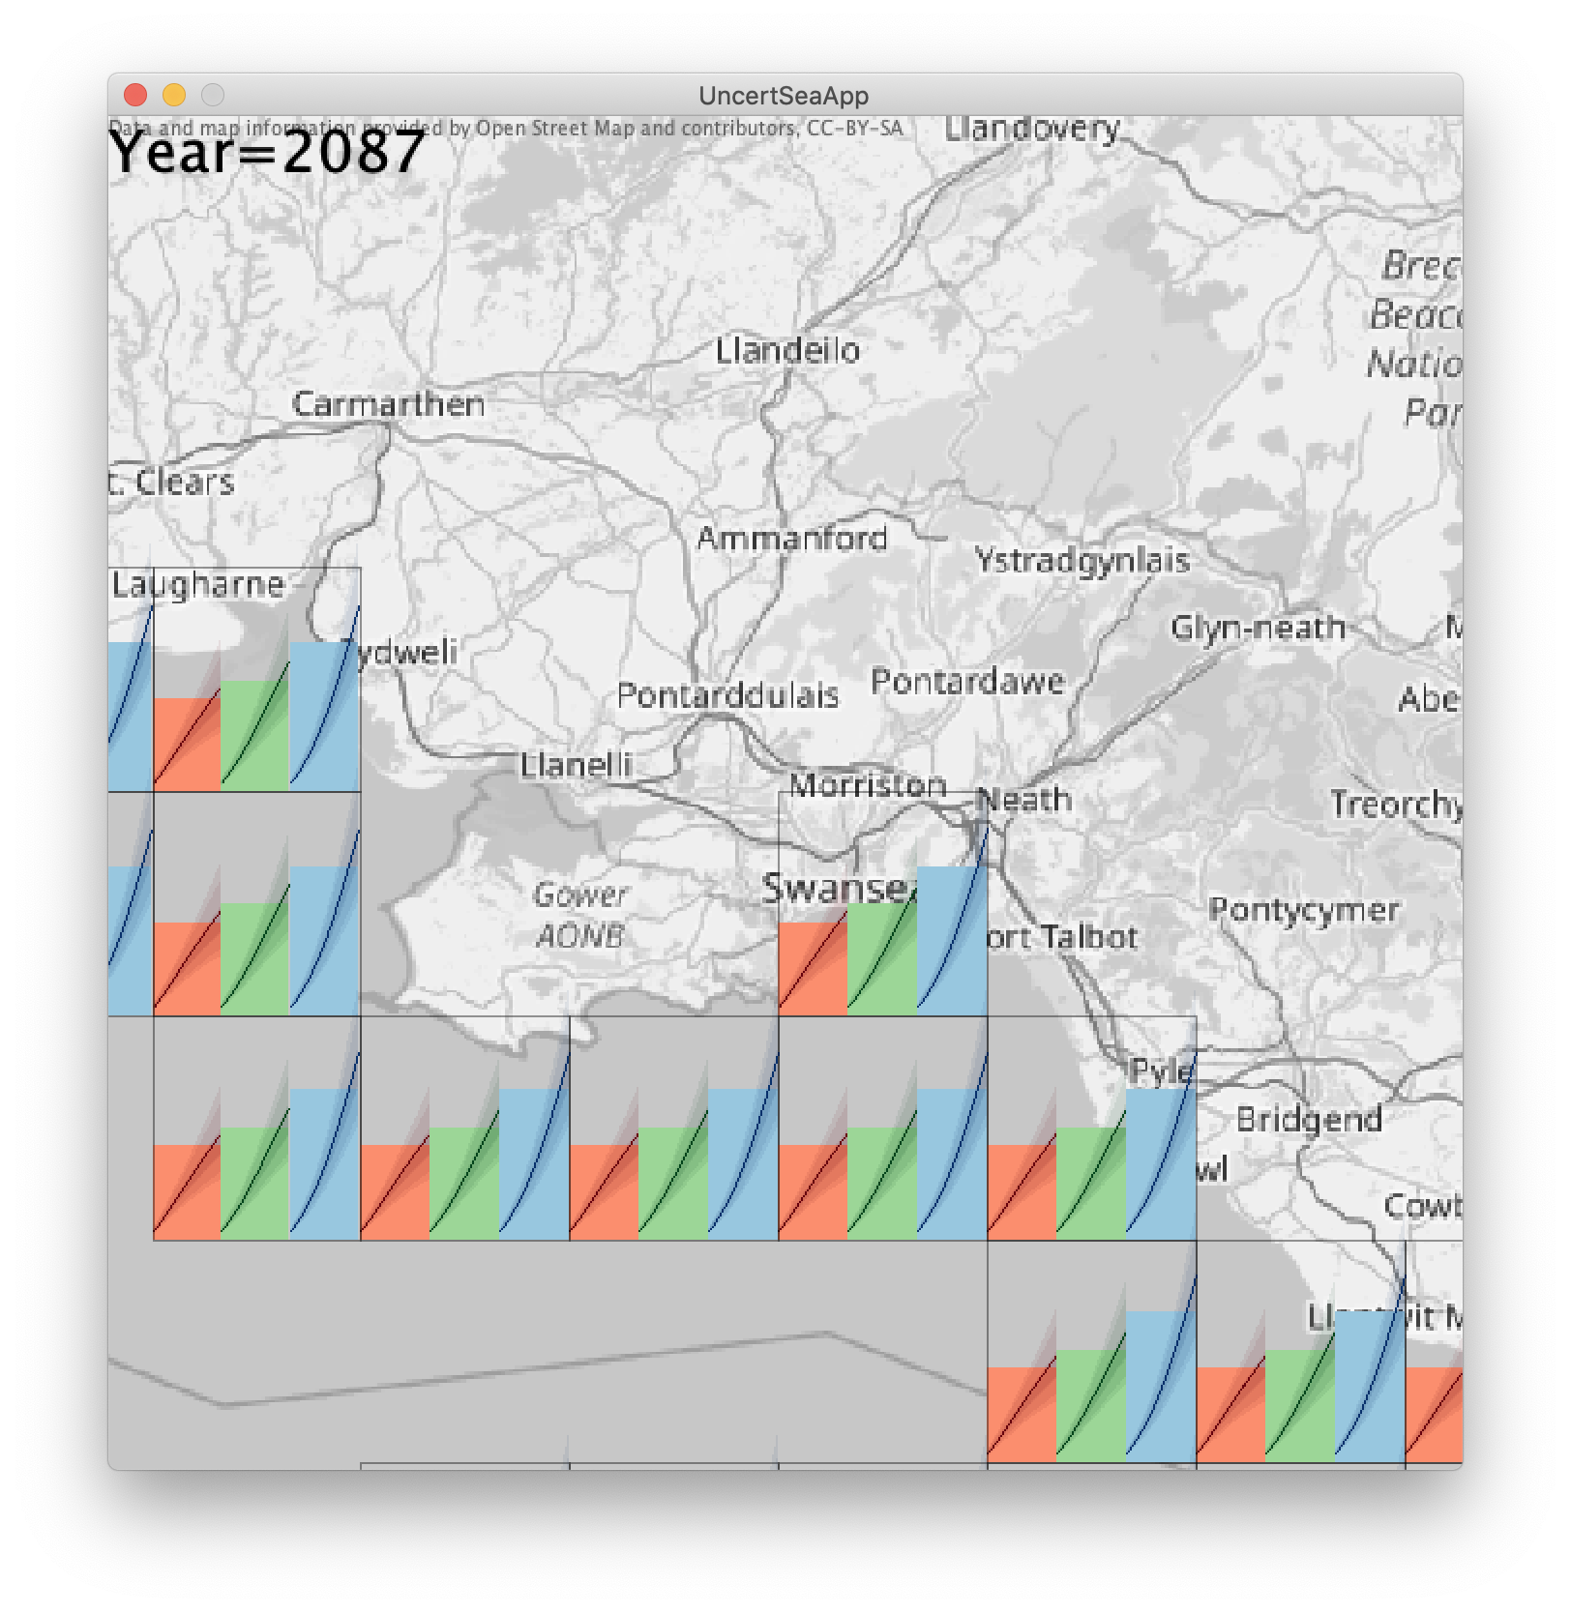
Uncertainties in UK-wide mean sea level rise

Slide 11
Software
Blender
Unity
Town halls
Stakeholder engagements
Conferences
Future Coastal Flood Risk
The UncertainSea Virtual Tool
Live demo…

Slide 12
Legend
Return periods

Slide 13
Project outline
UKCP18 sea level projections Still Water Return Level (2020-2100)
EA Extreme Sea Levels (2017) Using the Mumbles tidal gauge
Visualise future Extreme Sea Level uncertainties Using GIS, 3D rendering
Time horizons: Local government planning epoch end date (2025, 2055, 2100)
Case Study location: Swansea

Slide 14
Sources of Uncertainty
Extreme Sea Levels at defined return periods
5th, 50th, 95th percentiles → uncertainty from downscaling, ice melt
2.5th 50th, 97.5th percentiles → uncertainty in skew surge joint probability statistics
Risk projected to future climate RCP 2.6, RCP 4.5, RCP 8.5
Present risk of coastal flooding
Future risk of coastal flooding

Slide 15
What visuals will be most applicable to stakeholders?
What else can we consider?
Difference in exposure impacted for high percentiles versus low?
How might exposure change in the future?
Future flood defences?
Impact of coastal erosion, and its uncertainty (how significant is erosion for Swansea w.r.t other factors)?

Slide 16
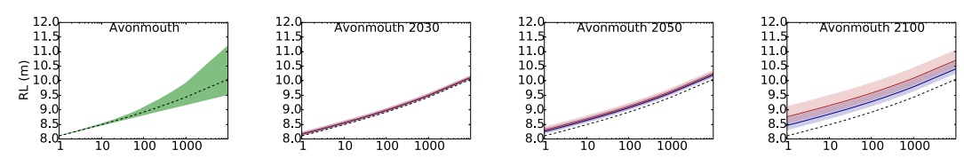
Figure 3.2.5. Projected future still water Return Level (RL) at Avonmouth. The present-day curve from Environment Agency (2018) is shown by the dashed black line (the lowest dashed line in each panel). Left-hand panels also show an estimate of the present-day uncertainty (green shading, showing 5th to 95th percentile). The blue (red) lines show the future return level curve under the central estimate of time-mean sea level change from the RCP2.6 (RCP8.5) scenario. The blue (red) shading shows the respective UKCP18 projection ranges. Uncertainty from the time-mean sea level projections is included. Uncertainty due to storminess changes is not included. Uncertainty in the present-day return level curves is not included in the projected future curves (see main text). Projections are shown for years 2030 (left column), 2050 (centre) and 2100 (right column). The uncertainties shown should be regarded as minimum uncertainties: for details see main text.

Slide 17
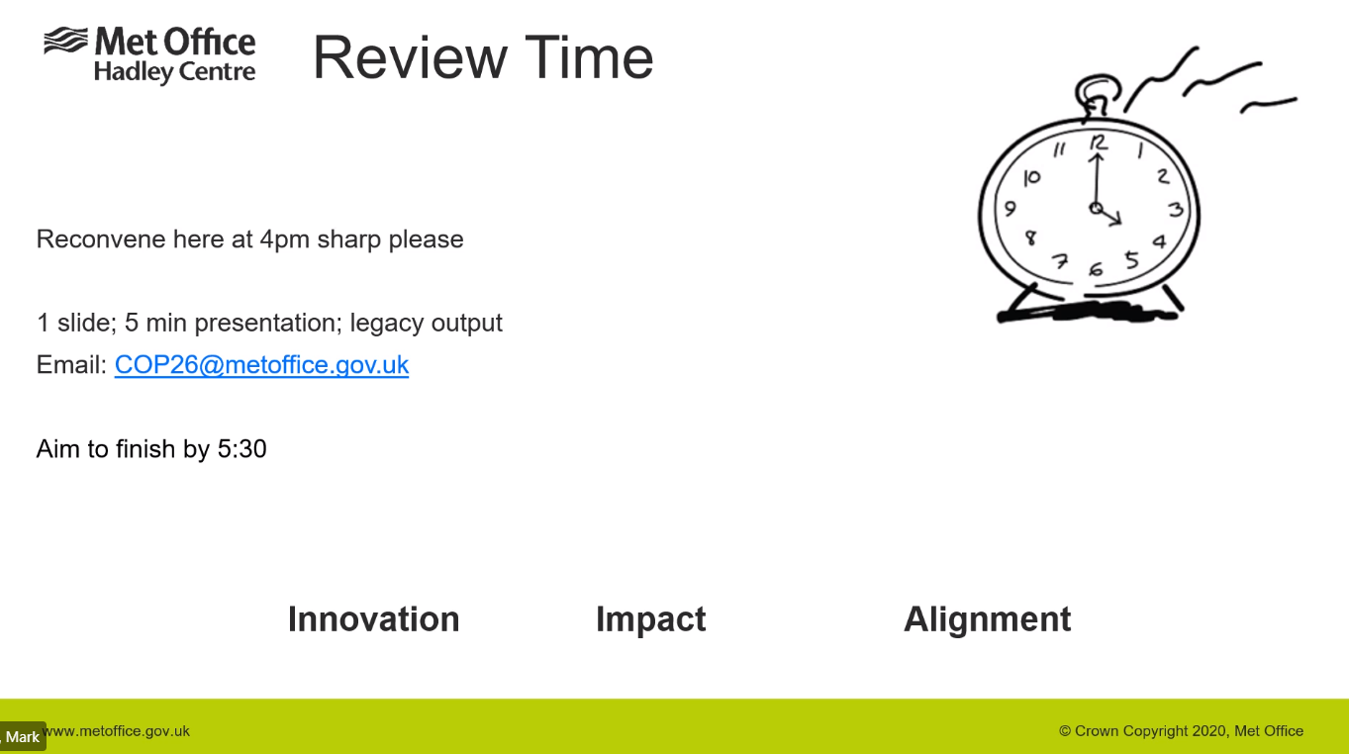

Slide 18
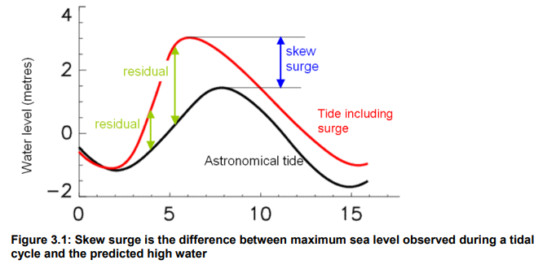
Caveats / Assumptions
Only considered uncertainty in future sea level projections and skew surge joint probability statistics in isolation
UKCP18 projected future return level curves
Include the uncertainties in the projections of regional mean sea level change (the dominant uncertainty) but not the uncertainties in the contribution from atmospheric storminess change. Does not include the uncertainties in the present-day return levels in the projections. Estimates of the uncertainty in the present-day return level curves are documented in a separate report (Environment Agency, 2018).
3D render @ 5m resolution
As noted in Howard et al (2019), “in recent work has indicated the importance of non-linear effects of MSL rise on the other components of change in sea-level extremes, particularly the effect on the inshore wave climate, and more research is required on these non-linear interactions.”
From Environment Agency (2018): Coastal flood boundary conditions for the UK: Technical summary report
Notes:
https://assets.publishing.service.gov.uk/government/uploads/system/uploads/attachment_data/file/827778/Coastal_flood_boundary_conditions_for_the_UK_2018_update_-_technical_report.pdf

Slide 19
Note 2: Extreme sea level values are for still water sea levels only ESL values include the effects of storm surge and astronomical tides but do not specifically account for any localised increase in sea level that may be induced by onshore wave action, orientation or topography. Two additional effects are of note and can be significant in certain circumstances. Wave set-up is an increase in water level due to on shore wave action (wave setdown is the opposite). Wind set-up is where the local wind shear stress pushes the water level up at the shore (and again set-down is the opposite). Depending on the circumstances these may or may not be well accounted for in the ESL estimates. Tide gauges can be exposed to these effects or sheltered from it.
Note 9: Confidence intervals The confidence levels presented in this report and in the shapefile of 2km return levels (CFB_Extreme_Sea_Levels_2018.shp or CFB_Extreme_Sea_Levels_Estuary_2018.shp in estuaries) take account of the uncertainty associated with the skew surge joint probability statistics only. Uncertainty relating to the accuracy of the CS3X model interpolation, 2km interpolation and tidal prediction is not included. Additional uncertainty due to model inaccuracies should be considered for points labelled ‘ESTUARY_’, which were derived using local models.
Skew surge joint probability method (SSJPM) → Central to this class of statistical models is the assumption that meteorological processes are independent of tidal processes, and so any surge can occur on any tide.
Notes:
51.546477, -4.020404

